Slide 1
Capstone Project
The battle of neighborhoods
EVAN XU on July 2, 2020

Slide 2
单击此处添加标题
01
02
03
Description
Data analysis
Conclusion
Including problem description, audience identification and some basic introduction of the methodology.
data acquisition, data wrangling, dataframe construction, data analysis
desicion making

Slide 3
Description
01
Including problem description, audience identification and some basic introduction of the methodology.

Slide 4
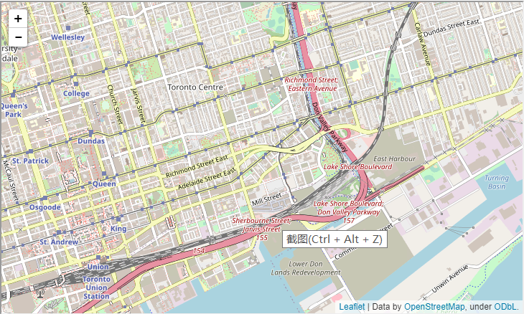
Description
The foursquare location data shows the distribution of groceries stores, cafes, retaurants in every venues of every neighborhood in Toronto. The whole idea of this project is to find the best location(particular venue in particular neighborhood) for openning a Chinese restaurant, using the foursquare location data to compare different neighborhoods
Foursquare map of Toronto

Slide 5
Methodology
·First get the geodata of Toronto.
·Segment different neighborhoods by their popularity and cluster using k-means clustering(k=5 should be enough for this project).
·Find the cluster with largest number of restaurants, in which determine the neighborhood with highest segmentation

Slide 6
Data analysis
02
data acquisition, data wrangling, dataframe construction, data analysis

Slide 7
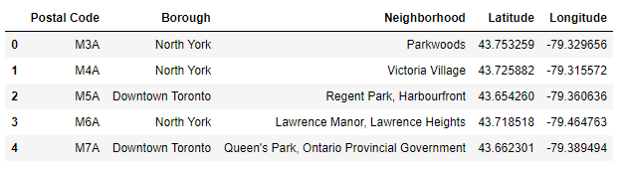
1.Data acquisition
Obtain location data of Toronto with details including postal code, borough, latitude and longitude.

Slide 8

2.Segmentation
Segmenting the 10 district of Toronto based on their popularity(distribution of races), transportation and number of Chinese restaurants
The district with higher segment will be better if you want to run a Chinese restaurant.

Slide 9
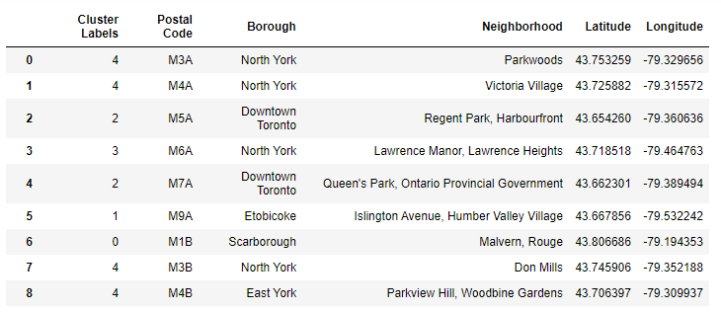
3.Clustering
Using k-means clustering as the machine learning technic to analyse the data.(k=5 should be enough in this case)

Slide 10
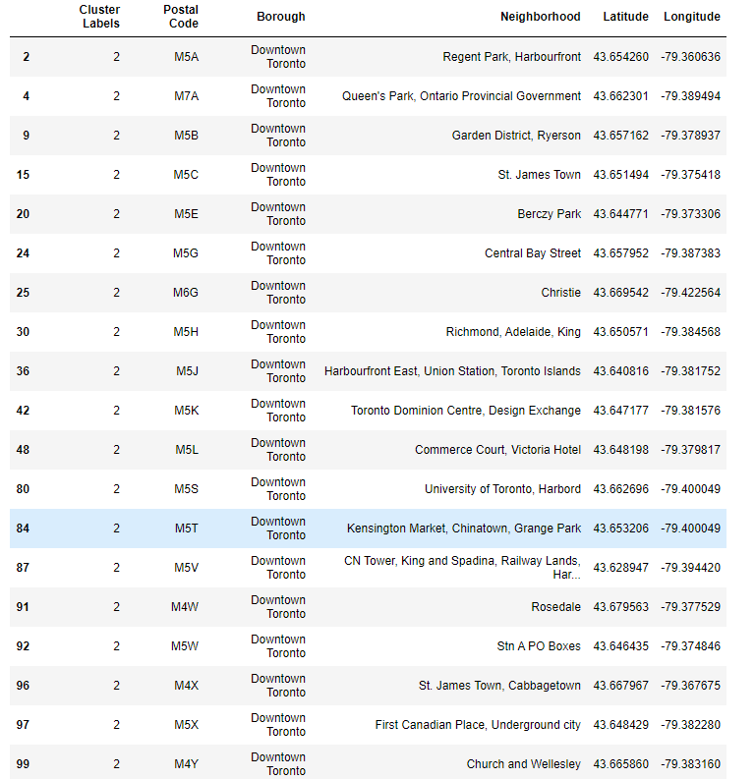

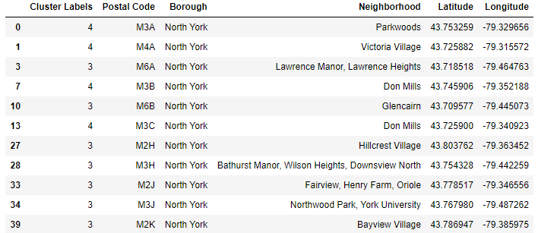
4.Comparison
By comparing different possible conbination, we want to find out the best location(neighborhood) for openning a Chinese restaurant

Slide 11
Conclusion
03
desicion making

Slide 12
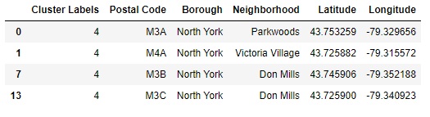
Conclusion
Though downtown Toronto has the highest segmentation with a Chinatown located in the neighborhood, it was all clustered into group 2 .
While North York was segmented the second best borough, some neighborhoods were clustered into group 4 which is the validated group.
Additionally, one particular neighborhood showed twice in the last shrinkage which is Don Mills.
Since then, the conclusion is that the best neighborhood for openning a Chinese restaurant will be Don Mills.

